Slide 1

TEAM MEMBERS – 1. Sai Teja Malladi (Project Manager) 2. Jahid Hassan (Project Owner) 3. Bhakti Palkar (Lead Business Analyst) 4. Tahera Shaikh (Lead Developer) 5. Nidhi Berde (Software Developer) 6. Rushda Manusri (QA Analyst) 7. Amala Natu (Software Tester) 8. Sai Manish Avasarala (Database Administrator)
Team 1 MaidEase

Slide 2
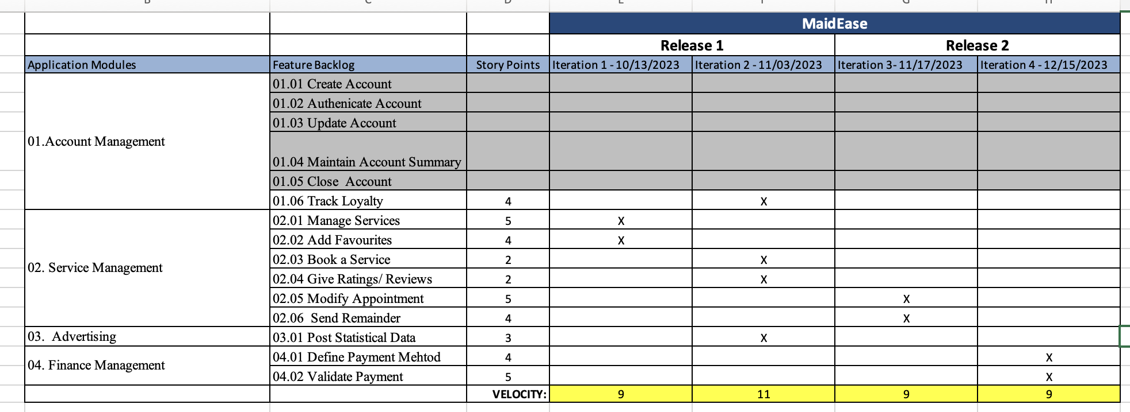
Roadmap(I3, I4)

Slide 3
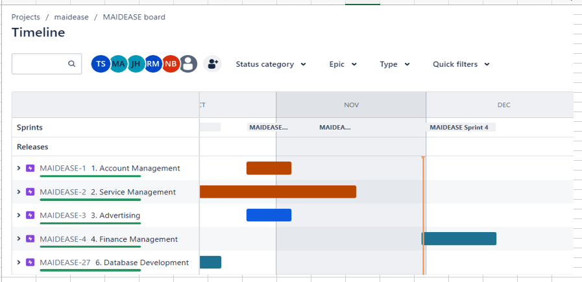
Jira RoadMap (I3, I4)

Slide 4
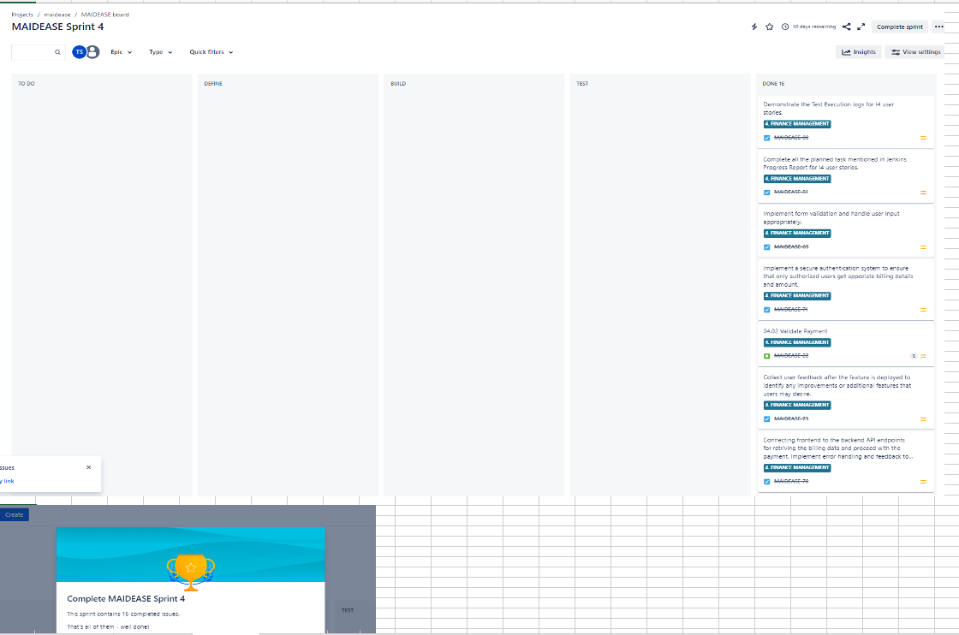
Kanban Board (I3, I4)

Slide 5
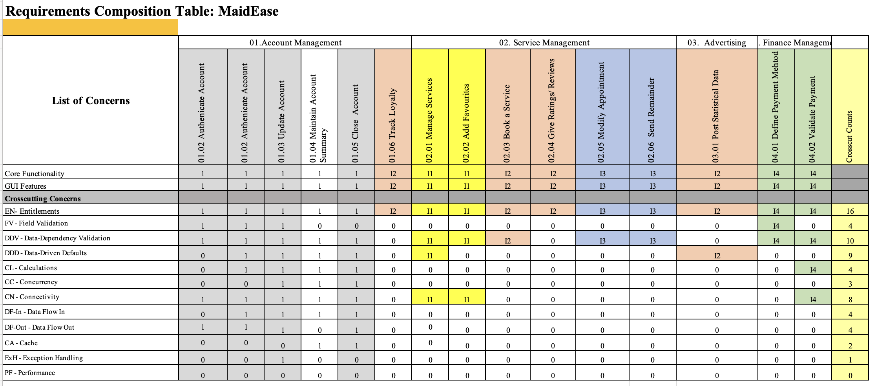
RCT Planning (I3, I4)

Slide 6
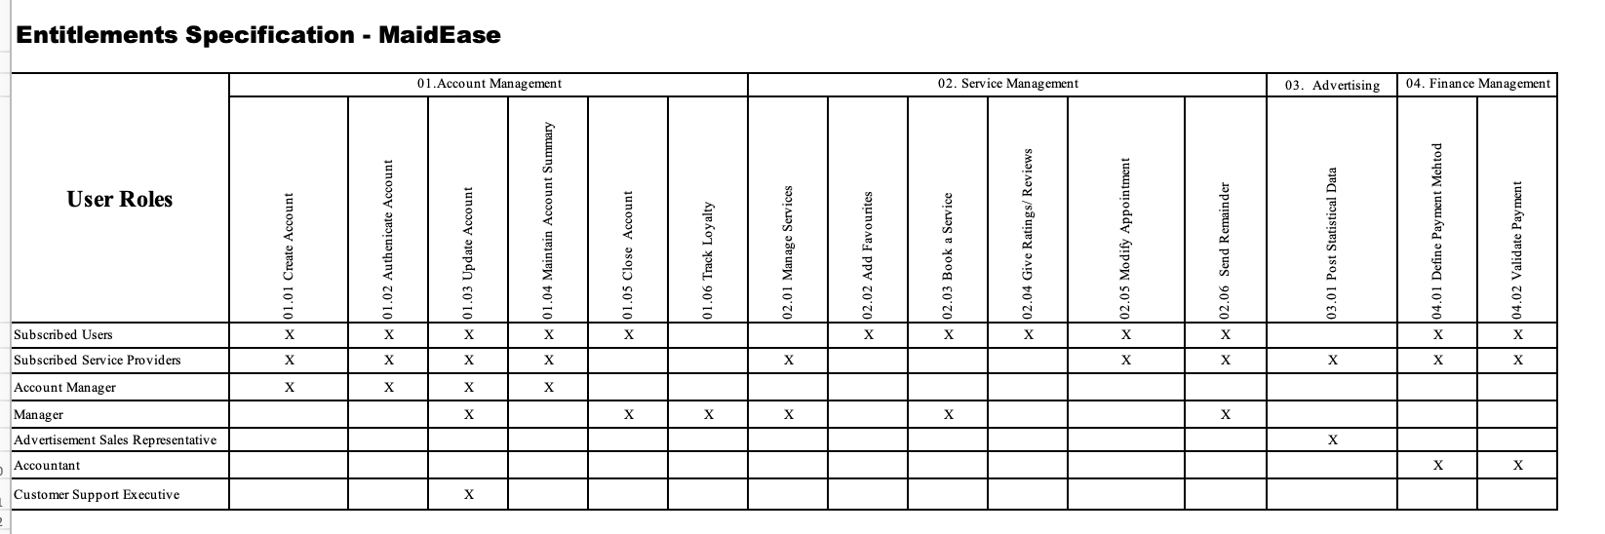
Actors Specification

Slide 7
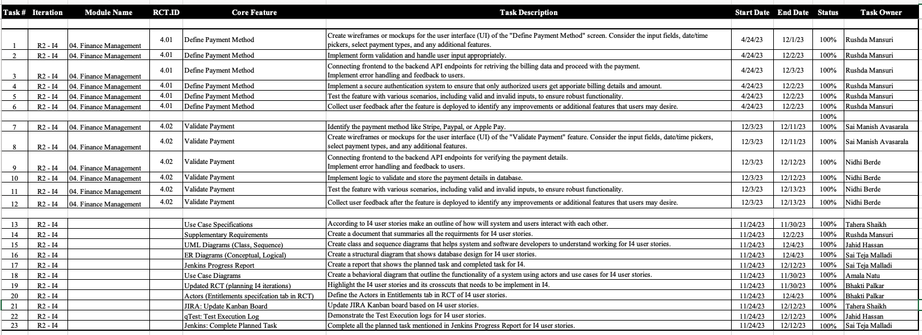
List of Tasks

Slide 8
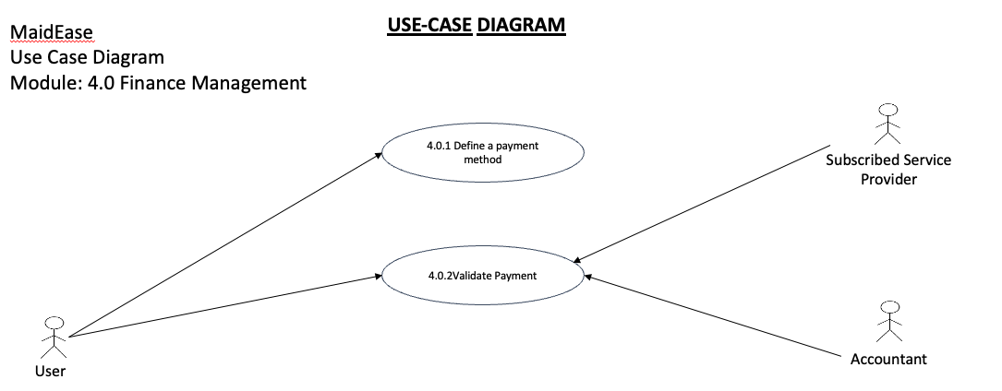
Use-case Diagrams

Slide 9
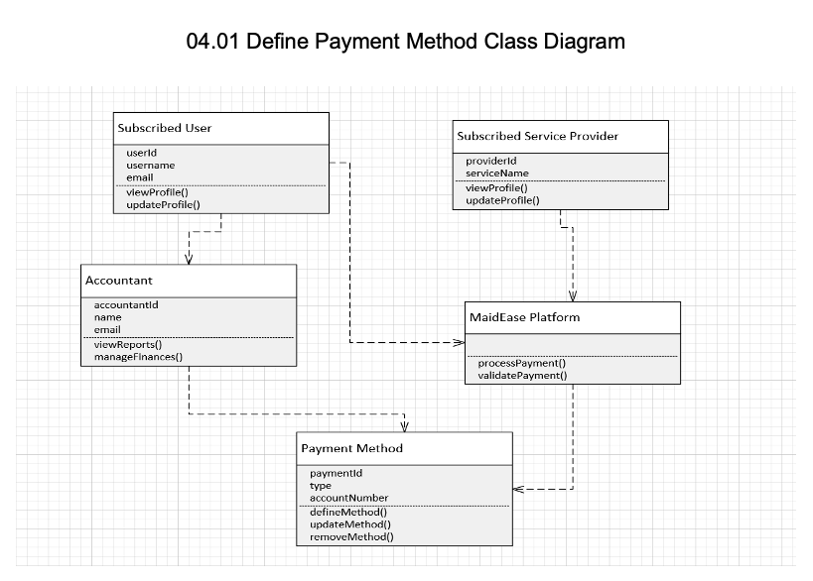
UML Diagrams

Slide 10
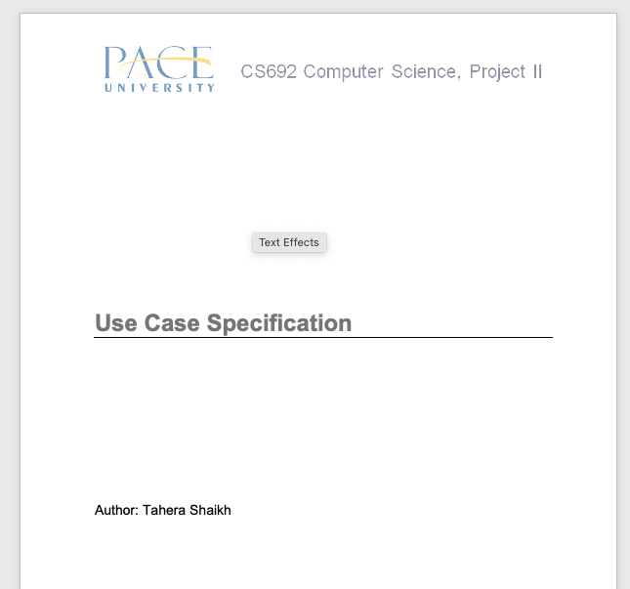
Use-Case Specifications

Slide 11
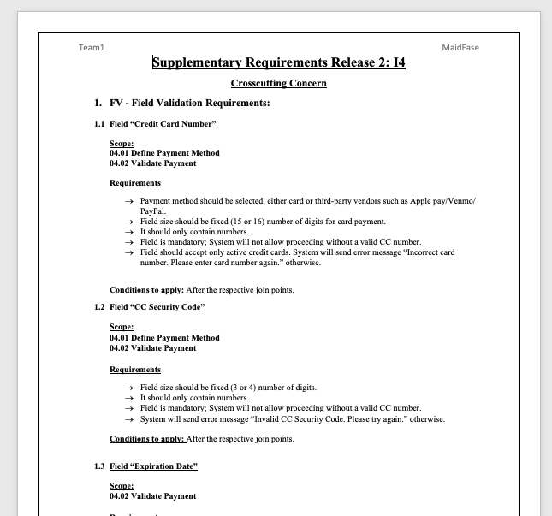
Supplementary Requirements

Slide 12
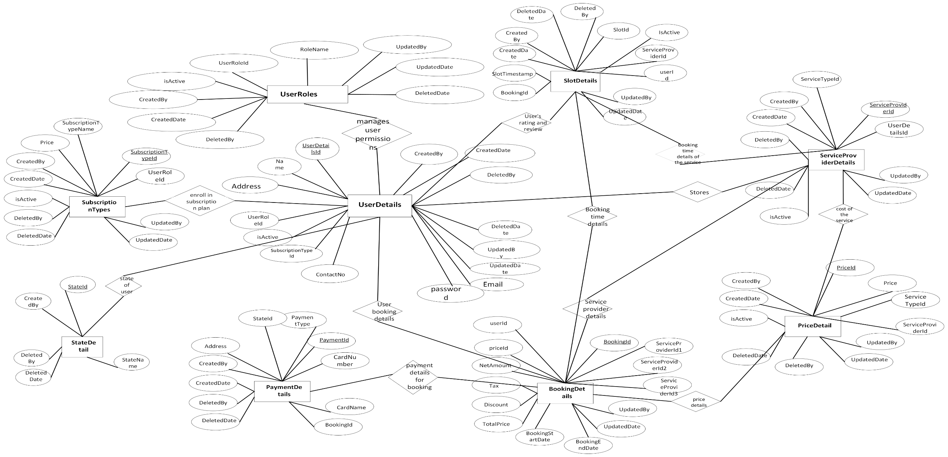
ER Diagrams

Slide 13
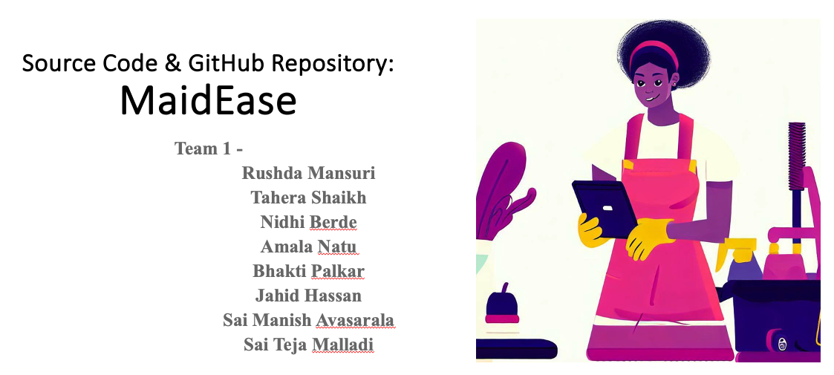
Git Source Code

Slide 14
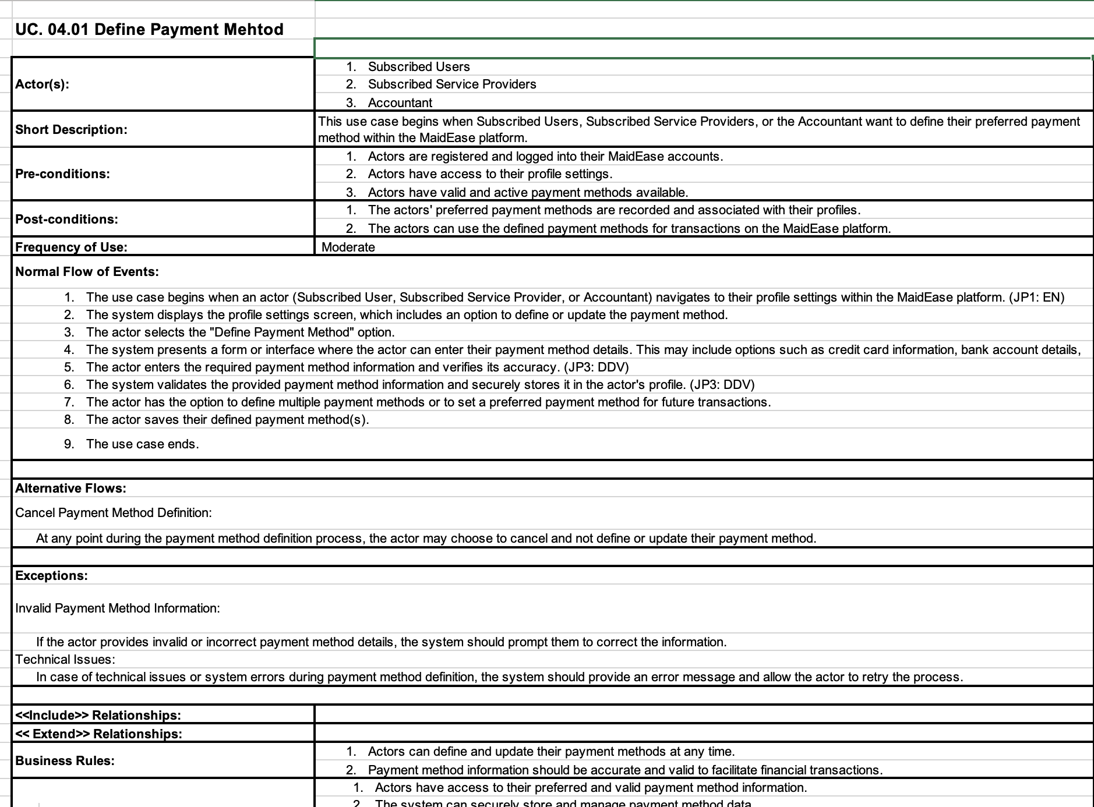
Functional Tests (I3, I4)

Slide 15
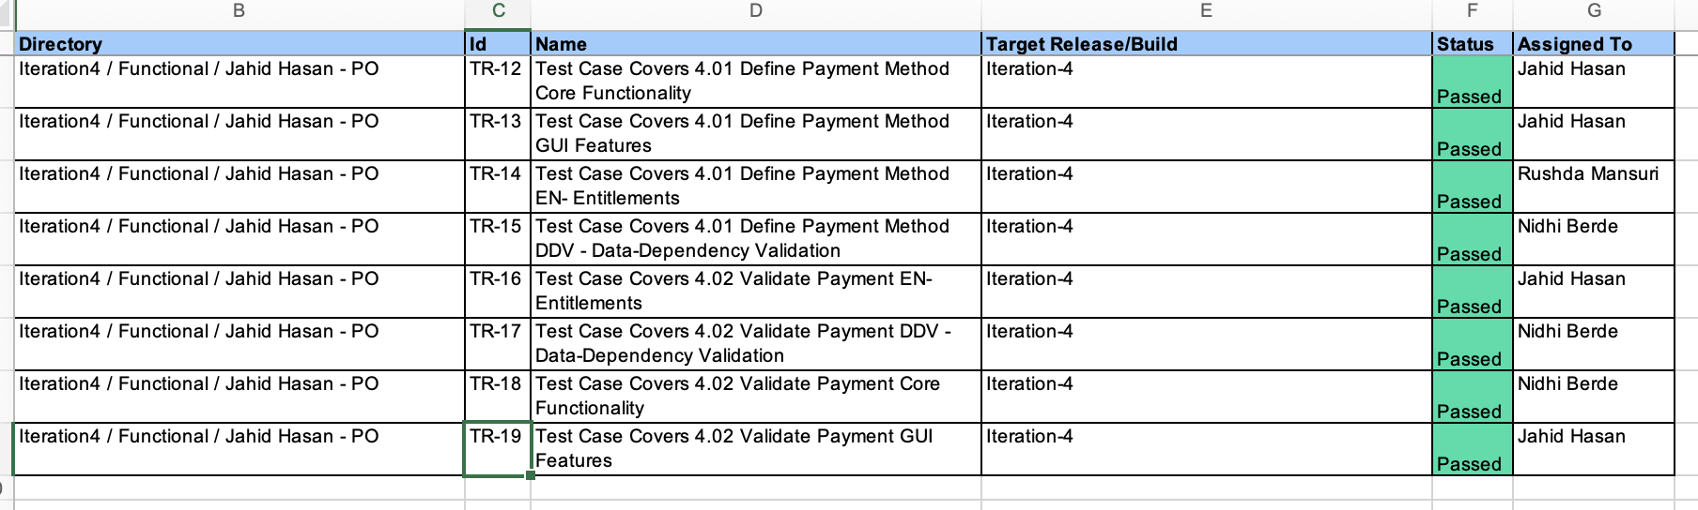
Test Execution Log (I3, I4)

Slide 16
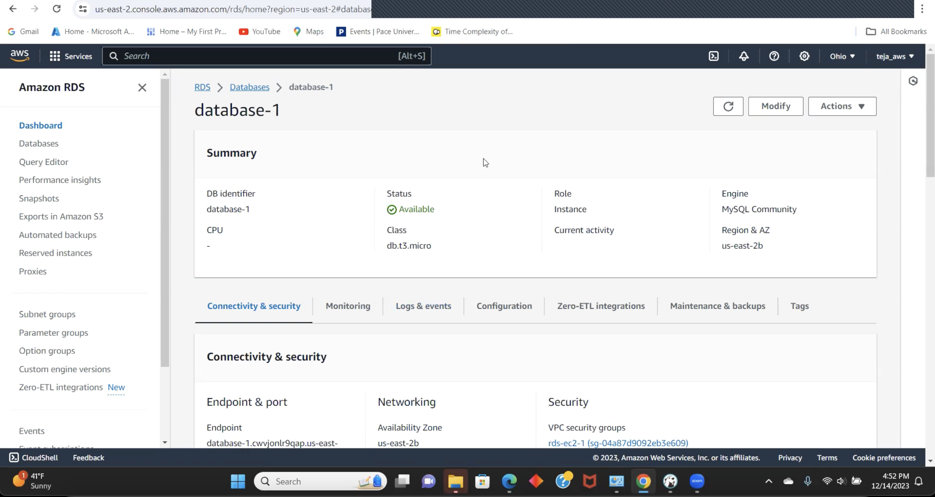
Jenkins Demo

Slide 17
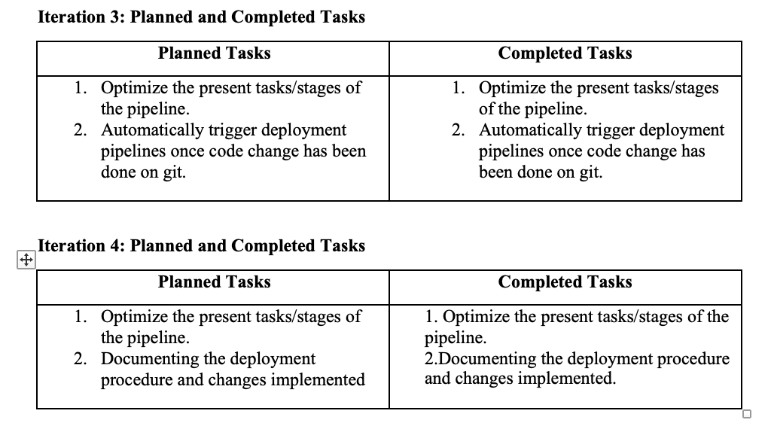
Jenkins Progress Report

Slide 18
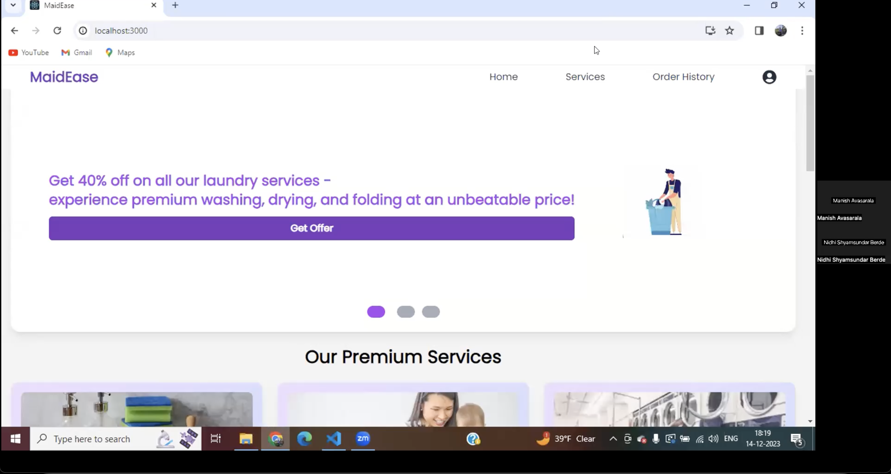
App Demo

